Slide 1



THE PUBLIC FINANCE DEBATES:
“It’s time…New Zealand extended charging for public infrastructure”
Proponent:
Geoff Cooper

Slide 2
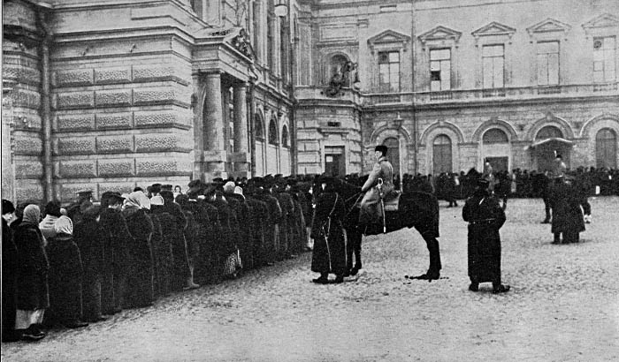
Rationing by queues
The VUW-GEN Public Finance Debates
November 12, 2013

Slide 3
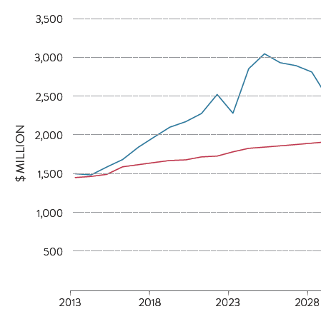

1. Raising revenue
The VUW-GEN Public Finance Debates
November 12, 2013

Slide 4
2. Economic Efficiency
The VUW-GEN Public Finance Debates
November 12, 2013

Slide 5
Fix the fiscal envelope
The VUW-GEN Public Finance Debates
November 12, 2013

Slide 6
Rise of the city
Population growth, largest New Zealand regions
The VUW-GEN Public Finance Debates
November 12, 2013

Slide 7
Congestion vs Auckland
Current network
2041 – fully funded transport programme
The VUW-GEN Public Finance Debates
November 12, 2013

Slide 8
City centre Travel Speeds
Current average speed: 17km/hour
2021 average speed: 8km/hour
The VUW-GEN Public Finance Debates
November 12, 2013

Slide 9
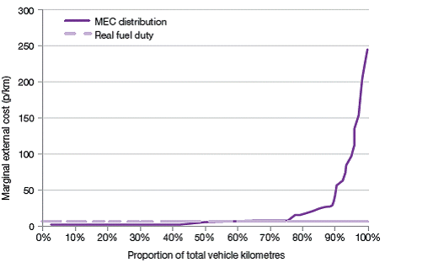
The marginal external cost of motoring
Completely ineffective
The VUW-GEN Public Finance Debates
November 12, 2013

Slide 10
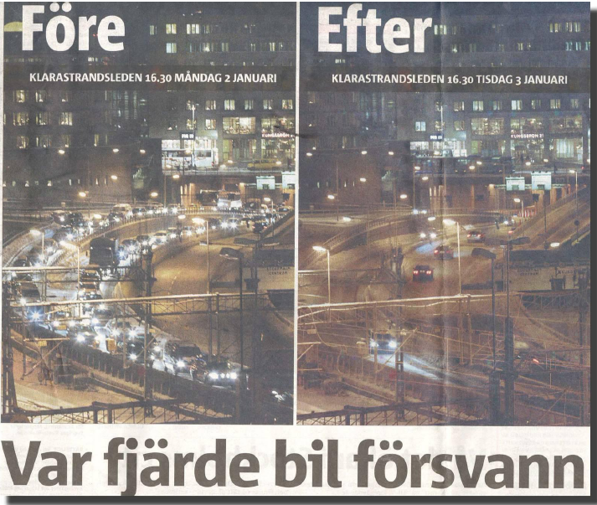
The VUW-GEN Public Finance Debates
November 12, 2013

Slide 11

Road pricing will release the potential of car pooling
The VUW-GEN Public Finance Debates
November 12, 2013

Slide 12
Road Pricing Cost benefit analysis
Milan €16m p.a
Copenhagen $36m p.a
Ministry of Transport:
Single Cordon: 1.3-3.4
Double Cordon: 1.3-3.5
Area Charge: 1.1-3.0
Auckland Council:
Single Cordon: 1.1
Motorway Network: 1.1
London £129m p.a
Stockholm €16m p.a
Seattle $20m p.a
The VUW-GEN Public Finance Debates
November 12, 2013

Slide 13
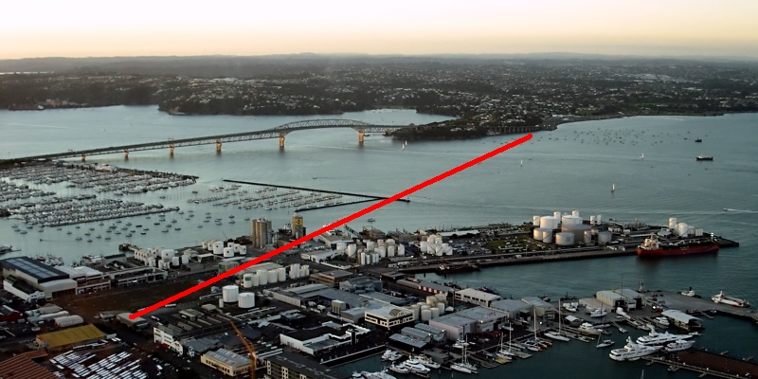
The $5 billion question
Do we need a second harbour bridge or will road pricing do?
The VUW-GEN Public Finance Debates
November 12, 2013

Slide 14
Annual flow - Current and proposed harbour crossing
The VUW-GEN Public Finance Debates
November 12, 2013

Slide 15
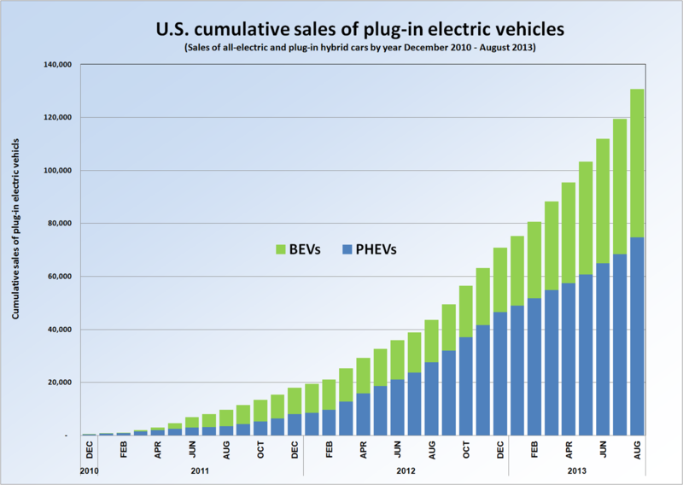
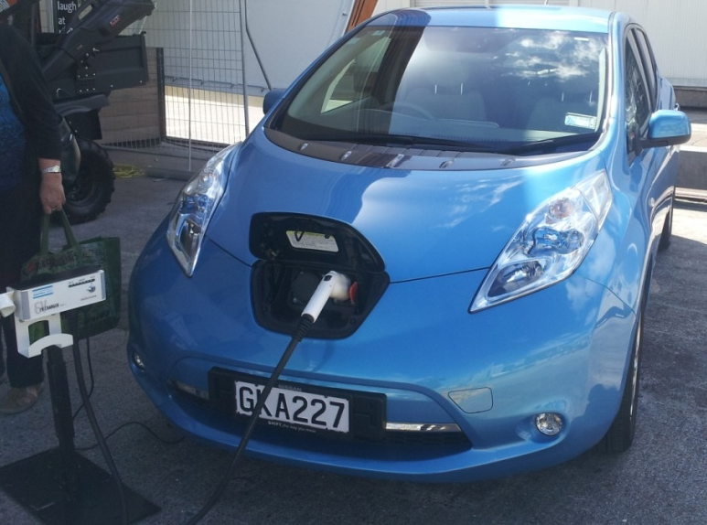
The current funding system is not sustainable anyway
The VUW-GEN Public Finance Debates
November 12, 2013

Slide 16
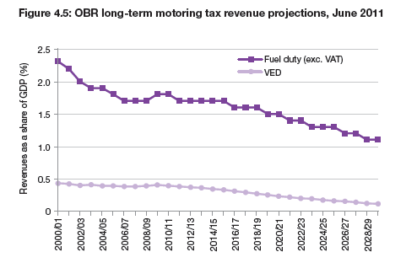
The VUW-GEN Public Finance Debates
November 12, 2013

Slide 17
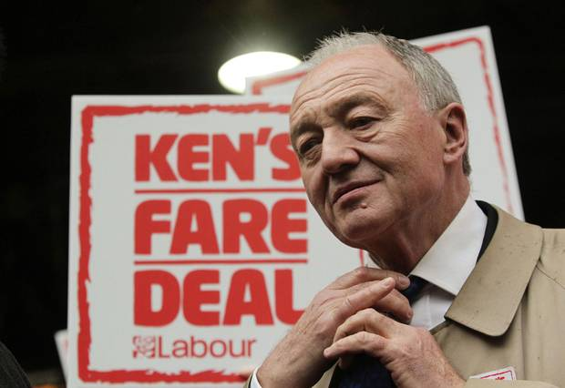
Road pricing need not be regressive
The VUW-GEN Public Finance Debates
November 12, 2013

Slide 18

Road pricing
Improve urban travel times
Free up New Zealand’s most productive employment areas.
Take advantage of spare capacity through car pooling
Positive cost benefit ratio
Sustainable system of revenue collection
Less regressive than the current system
More efficient - charge people who are
creating costs
Avoid unnecessary infrastructure costs
The VUW-GEN Public Finance Debates
November 12, 2013

Slide 19

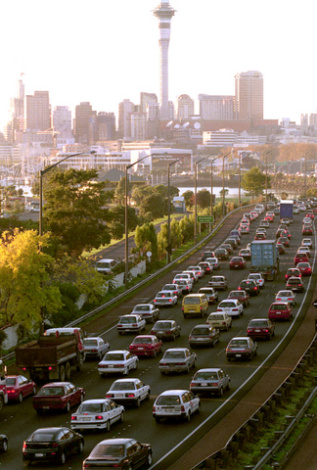
Is road pricing really that different to pricing bread?
The VUW-GEN Public Finance Debates
November 12, 2013

